Slide 1
To study the effect of mutation on the γ subunit of the COP1 protein complex Members Jeet Mukhopadhyay, Presidency University, UG-3 Arkaprabha Bhattacharya, Presidency University, UG-3 Spandan Banerjee, Presidency University, UG-3

Slide 2
KDEL sequence : Lysine, Aspartate, Glutamate, Leucine
Trafficking of cargo proteins between the Rough Endoplasmic Reticulum and the Golgi apparatus with the help of COP 1 and COP 2 vesicles.
Retrieval of ER bearing chaperone proteins involving the COP 1 vesicle protein.

Slide 3
COP 1 vesicle protein is involved in the retrograde trafficking of ER resident chaperones from the golgi to the Endoplasmic Reticulum (ER). Ceasation of this protein trafficking can lead to ER stress which can lead to several immunological disorders.

Slide 4
Different methods used to study the experiment : - 1) Confocal microscopy 2) SDS PAGE 3) ELISA 4) CRISPR /Cas9 5) Sangner sequencing 6) Time-Correlated Single-Photon Counting Fluorescence lifetime image microscopy

Slide 5
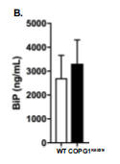
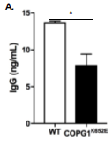
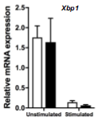
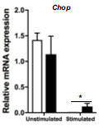
Results

Slide 6
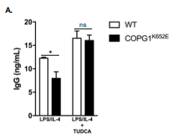
Conclusion
Tauroursodeoxycholic acid (TUDCA) , a bile acid , used in the treatment of liver cirrhosis behaves as a chaperone and can counter the ill effects of hindered protein transport back to the ER .

Slide 7
THANK YOU

